Slide 1
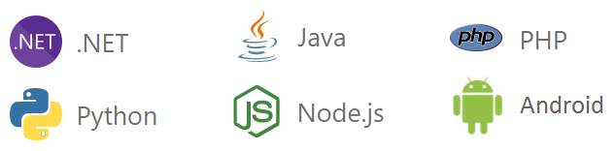
Microsoft Azure
Microsoft Azure is a cloud computing platform that makes it easy for businesses to create, deploy, and manage digital applications.
Microsoft Azure is a cloud computing platform and an online portal that allows you to access and manage cloud services and resources provided by Microsoft.
These services and resources include storing your data and transforming it, depending on your requirements.
To get access to these resources and services, all you need to have is an active internet connection and subscription to connect to the Azure portal.
Microsoft Azure helps you to build and manage enterprise level web, mobile, IoT apps faster using your existing skills and technologies you know.

Slide 2
Microsoft Azure
It was launched on February 1, 2010, significantly later than its main competitor, AWS.
It’s free to start and follows a pay-per-use model, which means you pay only for the services you opt for.
Azure supports multiple programming languages, including Java, Node Js, and C#.

Slide 3
Why Use Azure?
Application development: You can create any web application in Azure.
Testing: After developing an application successfully on the platform, you can test it.
Application hosting: Once the testing is done, Azure can help you host the application.
You can create virtual machines in any configuration you want with the help of Azure.
Azure offers a very good Platform as a Service (PaaS) with excellent tools and building blocks.
It offers compatibility with .NET programming languages which is a great advantage.
The security and data protection feature of Azure is second to none in the cloud domain.
Azure offers excellent hybrid cloud features and easy migration from on-premise to cloud.
It gives an integrated environment for app development, testing, and deployment in the cloud.
You can learn Azure without any hassles and successfully set up an Azure cloud infrastructure.
Azure has enterprise agreements with Windows users making it easy for them to migrate to Azure.

Slide 4
Advantages of Microsoft Azure
Cost
Microsoft Azure reduce the effort and cost of buying hardware, software. It also reduce the cost of building and extending on-premises resources like round-the-clock electricity for power and cooling, the IT experts for managing the infrastructure.
Speed
Microsoft Azure provides on demand services and a wide range of computing resources which can be configured with the help a few mouse clicks. It gives a lot of flexibility and respond quickly to changes in your business and customer needs.
Global Scale
Using Microsoft Azure you can scale your IT resources up and down based on your needs. You can consume computing resources, storage, bandwidth ONLY when the needs arise and from the right geographic location.
Productivity
Datacenters typically require a lot of effort in managing the hardware, software set up, software patching, data backup and other resources. Microsoft Azure eliminates the need of such type tasks, so that IT team can spend time on achieving more important business goals rather than managing datacenters.

Slide 5
Advantages of Microsoft Azure
Performance
Microsoft Azure cloud services and resources run on a worldwide network of secure datacenters, which are regularly upgraded to the latest generation of fast and efficient computing hardware and software. This offers better performance.
Reliability
Microsoft Azure cloud computing makes data backup, disaster recovery, and IT services easier and less expensive, since they mirror you data at multiple places on theirs datacenters.

Slide 6
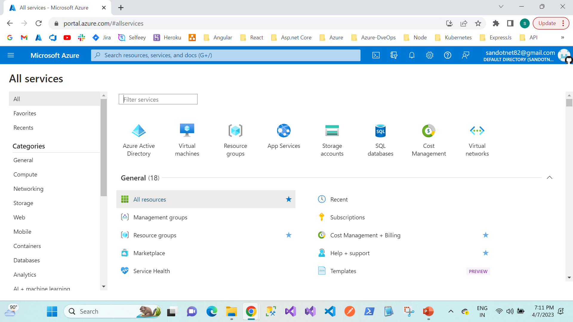
Getting Started with Microsoft Azure Platform

Slide 7
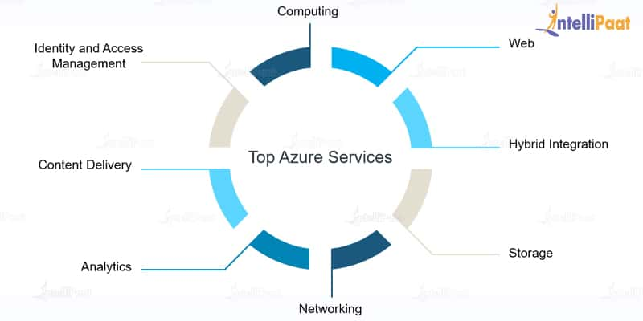
Azure Services

Slide 8
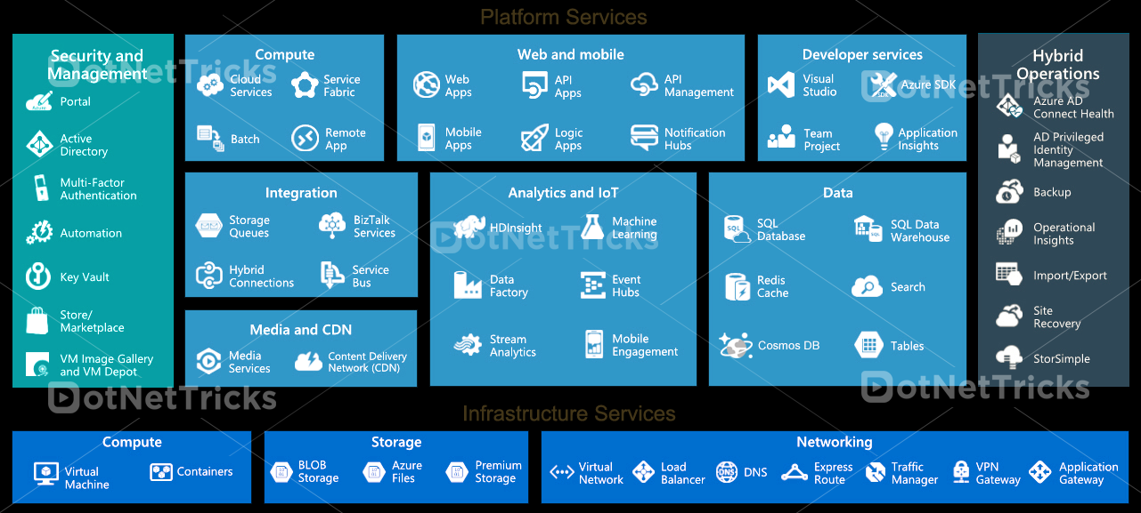
Microsoft Azure Services
Microsoft Azure offers so many services through its cloud computing platform.

Slide 9
Microsoft Azure Services
Compute Services
Compute services are used for cloud computing operations like app building, hosting and deployment in Azure Platform.
Virtual Machine
Virtual Machine allows you to deploy any app, language and any operating system (windows,linux and ubuntu) virtually on a machine.
Azure Container Service
Azure Container Service allows you to create a container hosting solution optimized for Azure. It can be used to scale and orchestrate applications using DC/OS, Docker Swarm or Kube Azure Compute Services.
Azure Container Registry
Store and manage container images across all types of Azure deployments.
Functions
Azure Functions is a serverless compute service which allows you to run code on-demand regardless of infrastructure and provisioning of servers. Use Azure Functions to run a script or piece of code in response to a variety of events.
Service Fabric
Service Fabric simplify microservice-based application development and lifecycle management. It delivers low-latency performance and efficiency at massive scale.
AppServices
App Services allows you to deploy highly-available, massively-scalable applications and APIs. Cloud Services support deployment of Java, Node.js, PHP, Python, .NET and Ruby.

Slide 10
Microsoft Azure Services
Azure Networking
Azure Networking allows you to connect privately and securely to Cloud with Azure ExpressRoute and distribute user traffic to specific endpoints with Azure Traffic Manager.
Virtual Network
Perform Network isolation and segmentation. Filter and Route network traffic.
Load Balancer
Delivers high availability and network performance to your applications. Load balance incoming Internet traffic to Virtual Machines. Forward external traffic to a specific virtual machine.
Application Gateway
It is a dedicated virtual appliance providing Application Delivery Controller (ADC) as a service. Comprised of multiple worker instances for scalability and high availability Azure Networking Services.
VPN Gateway
A type of virtual network gateway that sends encrypted traffic across a public connection. Use VPN gateways to send traffic between Azure virtual networks over the Microsoft network.
Content Delivery Network (CDN)
CDN caches static web content at strategically placed locations to provide maximum throughput for delivering content to users.
Azure DNS
DNS is responsible for translating a website or service name to its IP address. Azure DNS is a hosting service for DNS domains, providing name resolution using Microsoft Azure infrastructure Azure Networking Services.
Traffic Manager
Allows you to control the distribution of user traffic for service endpoints such as, Azure VMs, Web Apps, and cloud services in different Data centers.

Slide 11
Microsoft Azure Services
Azure Storage Services
Azure Storage Services provides cloud storage solution for modern applications that rely on durability, availability, and scalability to meet the needs of their customers.
Blob Storage
Azure Blob storage is a service that stores unstructured data in the cloud as objects/blobs. It can store any type of text or binary data, such as a document, media file, or application installer.
Queue Storage
Azure Queue storage provides cloud messaging between application components. Queue storage delivers asynchronous messaging for communication between application components.
Table Storage
Azure Table storage is a service that stores semi-structured NoSQL data in the cloud, providing a key/attribute store with a schema less design.
File Storage
Offers file shares in the cloud using the standard Server Message Block (SMB) Protocol. With Azure File storage, you can migrate legacy applications that rely on file shares to Azure quickly and without costly rewrites Azure Storage Services.

Slide 12
Microsoft Azure Services
Azure Database Services
SQL Database
SQL Database is a relational database service in the Microsoft cloud based on the market-leading Microsoft SQL Server engine.
CosmosDB
Redis Cache
Managed by Microsoft. It is a secure and dedicated Redis cache, which is an advanced key-value store, where keys can contain data structures such as strings, hashes, lists, sets, and sorted sets.
Enterprise Integration Services
Service Bus
Microsoft Azure Service Bus is a reliable information delivery service which is a brokered, or third-party communication mechanism. The Service Relay service supports traditional one-way messaging, request/response messaging, and peer-to-peer messaging.
SQL Server Stretch Database
Stretch Database migrates your cold data transparently and securely to the Microsoft Azure cloud. Stretch Database targets transactional databases with large amounts of cold data, typically stored in a small number of tables.

Slide 13
Applications of Azure
Development: Azure helps in successful software development by assisting with code sharing, testing applications, troubleshooting, software development kits, and so on.
DevOps: Azure DevOps offers a complete set of tools and services for DevOps implementation that includes application diagnostics, test labs for build testing, experimentation, Visual Studio Team Services, and so on.
Machine Learning: Machine Learning applications offered by Azure include those used for creating powerful AI and cognitive computing models, datasets for training the models, and so on.
Containerization: Containerization services include the Azure platform for Docker and Kubernetes implementation for creating and orchestrating huge volumes of containers.
Internet of Things: Azure offers multiple services for capturing, monitoring, and analyzing the IoT data that emanates from sensors and other devices, and then for analyzing and monitoring issue notifications and support for the successful IoT implementation.
IT Security: This includes identifying and responding to IT security in the cloud and also managing sensitive assets and encryption keys.

